Slide 1
Education Opportunities
Notes:
Recommended Facilitation Time: 60 mins
FACILITATOR GUIDE:
Career Planning has many facets, setting goals and expectations for yourself will push you to be your best version.

Slide 2
Enabling Objectives
IDENTIFY education opportunities:
EXPLAIN education programs available within the Navy
Online Academic Skills Course (OASC)
Navy's Voluntary Education Program (VOLED)
Tuition Assistance (TA))
Navy College Program
United States Navy Community College (USNCC)
Joint Service Transcript (JST)
Navy Credentialing Opportunities On-Line (Navy COOL)
Notes:
FACILITATOR GUIDE:
Review objectives

Slide 3
Enabling Objectives
EXPLAIN education programs available within the Navy
United Services Military Apprenticeship Program (USMAP)
Defense Activity for Non-Traditional Education Support (DANTES)
My Career Advancement Account (MyCAA)
DoDMWR Library Resources
Montgomery G.I. Bill and Post 9/11 G.I. Bill
Notes:
FACILITATOR GUIDE:
Review objectives

Slide 4
References
www.navycollege.navy.mil
www.usncc.edu
www.jst.doded.mil/jst
www.cool.osd.mil
usmap.netc.navy.mil/usmap
dodmwrlibraries.org/continuing-education
www.dantes.doded.mil
www.benefits.va.gov/gibill/
mycaa.militaryonesource.mil/mycaa/
MILPERSMAN 1780-011- Transfer of Education Benefits
Notes:
FACILITATOR GUIDE:
To apply for TA and for TEB SOU www.navycollege.navy.mil
www.usncc.edu USN Community College
www.jst.doded.mil/jst Joint Service Transcript
www.cool.osd.mil Navy Credentialing
Usmap.netc.navy.mil/usmap United Services Military Apprenticeship Program provides servicemembers the opportunity to improve their job skills and to complete their job skills and to complete their civilian apprenticeship requirements while they are active duty
dodmwrlibraries.org/continuing-education - EBSCO LearningExpress provides interactive tutorials, practice tests, e-books, flashcards and articles for academic skill-building, career advancement and standardized test preparation.
www.dantes.doded.mil The Defense Activity for Non-Traditional Education Support provides free education and career-planning programs for U.S. armed forces members. DANTES programs help service members throughout their military career and transition to civilian life.
www.benefits.va.gov/gibill/ for the GI Bill, which provides education benefits to veterans, service members, and their families. It helps support costs for college, graduate school, and training programs, ensuring that those who've served in the military have access to educational opportunities.
Mycaa.militaryonesource.mil/mycaa/- directs you to the My Career Advancement Account (MyCAA) Scholarship program. It provides eligible military spouses with up to $4,000 in financial assistance to pursue licenses, certifications, or associate degrees needed for employment in high-demand career fields
MILPERSMAN 1780-011- Transfer of Education Benefits

Slide 5
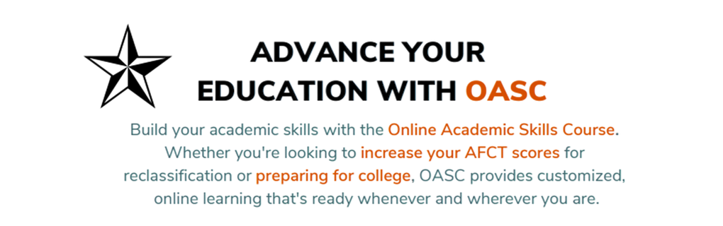
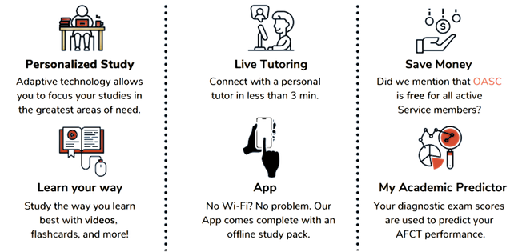


Slide 6

Voluntary Education (VOLED)
The Navy’s Voluntary Education program encompasses Tuition Assistance (TA) and the Navy College Program for Afloat College Education (NCPACE), which funds off duty education. Why is VOLED important?
Assists in developing a highly adaptable force
Enables career-long planning
Enhances personal and professional development
Recruitment and retention
Promotion (FMS) points
Notes:
FACILITATOR GUIDE:
1. Access www.navycollege.navy.mil to review most the current VOLED newsletter
2. TA provides financial assistance for tuition costs for a college, university, or vocational/technical institution.
Question to ask the class: What does VOLED stand for? Voluntary Education

Slide 7
TA/NCPACE Eligibility
Must have 3 years Time In Service
Passed most recent PFA and taken and passed most recent NWAE/RKE
NCPACE is only for Sailors assigned to Type 2 and Type 4 commands
Are not under instruction in initial skills training or in a duty under instruction (DUINS) training Status.
Attend a school accredited by a regional or national accrediting agency recognized by the U.S. Department of Education
Sailors with less than 16 years of service must have at least 6 months from the course start date until the end of their EAOS/SEAOS.
All TA or NCPACE funded courses must be completed while the member is on active-duty.
Notes:
FACILITATOR GUIDE:
1. Review most current NAVADMIN for eligibility requirements.
2. Introduce Command ESO and discuss the current policy for TA.
3. Ensure the caps semester hours, quarter hours, and clock hours is briefed.
4. Discuss lifetime cap for both TA and NCPACE combined.
5. TA funds Associate, Bachelors, and Masters degrees. Certificates are also funded. Sailors who do not possess a high school diploma can also have their remaining courses funded by TA (courses funded towards a high school diploma do not take away from lifetime cap).
Additional Notes:
NAVADMIN 214/21, discusses the minimum service requirement of 3 years.
NCPACE: Classes are distance-learning and do not require ongoing internet access to complete. Sailors will complete a one-time download of course materials at the start of the term and a one-time upload of completed coursework at the end.
Question to ask the class: What is the earliest/latest TA can be submitted? 120 days/no later than 7 days prior to the class start date.

Slide 8
Navy College Resources
Navy College Virtual Education Center (NCVEC) is staffed by education counselors who provide education counseling services
Visit Navy College Program website and search for Navy College Assistance Center, click Chat Now to chat online with a Counselor Mon-Fri 0700-1900 (EST)
MNCC Phone Number 833-330-MNCC (6622)
Select Option 3 "Education & Training", then Option 1 “Navy College, Tuition Assistance and Counseling”
Notes:
FACILITATOR GUIDE:
1. Go to www.navycollege.navy.mil to show members how to access website
2. After hours MNCC will answer and create a trouble ticket for Navy College. The Education counselors will receive the trouble ticket and will call or email the Sailor back. Advise Sailors to ensure they provide accurate contact information to MNCC.
Question to ask the class:
What does NCVEC stand for? Navy College Virtual Education Center
What days/hours are counselors available? 0700-1900 est

Slide 9

Navy College Resources
Degree Exploration
Provides Sailors with various tools to research education paths, degree plans, and academic institutions
CareerPath DECIDE
Kuder Journey
MilGears – Powered by COOL
TA Decide
Notes:
Degree Exploration:
CareerPath DECIDE is a decision support tool to help service members and veterans identify, prepare for and increase their employment qualifications. This can help them as they transition from military service to the civilian workforce. The tool can identify best-fit careers based on military occupation, education, and experience. Service members can find the right credentials and/or degree programs to fill their experience and education gaps.
Kuder Journey: Provides tools to assess your interests, suggests education and career options, prepares you for the job search, and connects you to today's jobs.
MilGears: A customized career-building tool developed to assist you while you serve, through transition, and beyond. Helps you plan and achieve your goals by highlighting career possibilities and helping you visualize how to reach those goals. MilGears analyzes your unique history—your military duties and training, civilian education and credentialing, and apprenticeships—to provide customized results.
TA Decide: Tool for comparing schools and programs. Designed for participants of TA, it provides education costs and outcomes, as well as information about other military students who are participating in the tuition assistance program.
Visit https://www.navycollege.navy.mil/ for more information

Slide 10

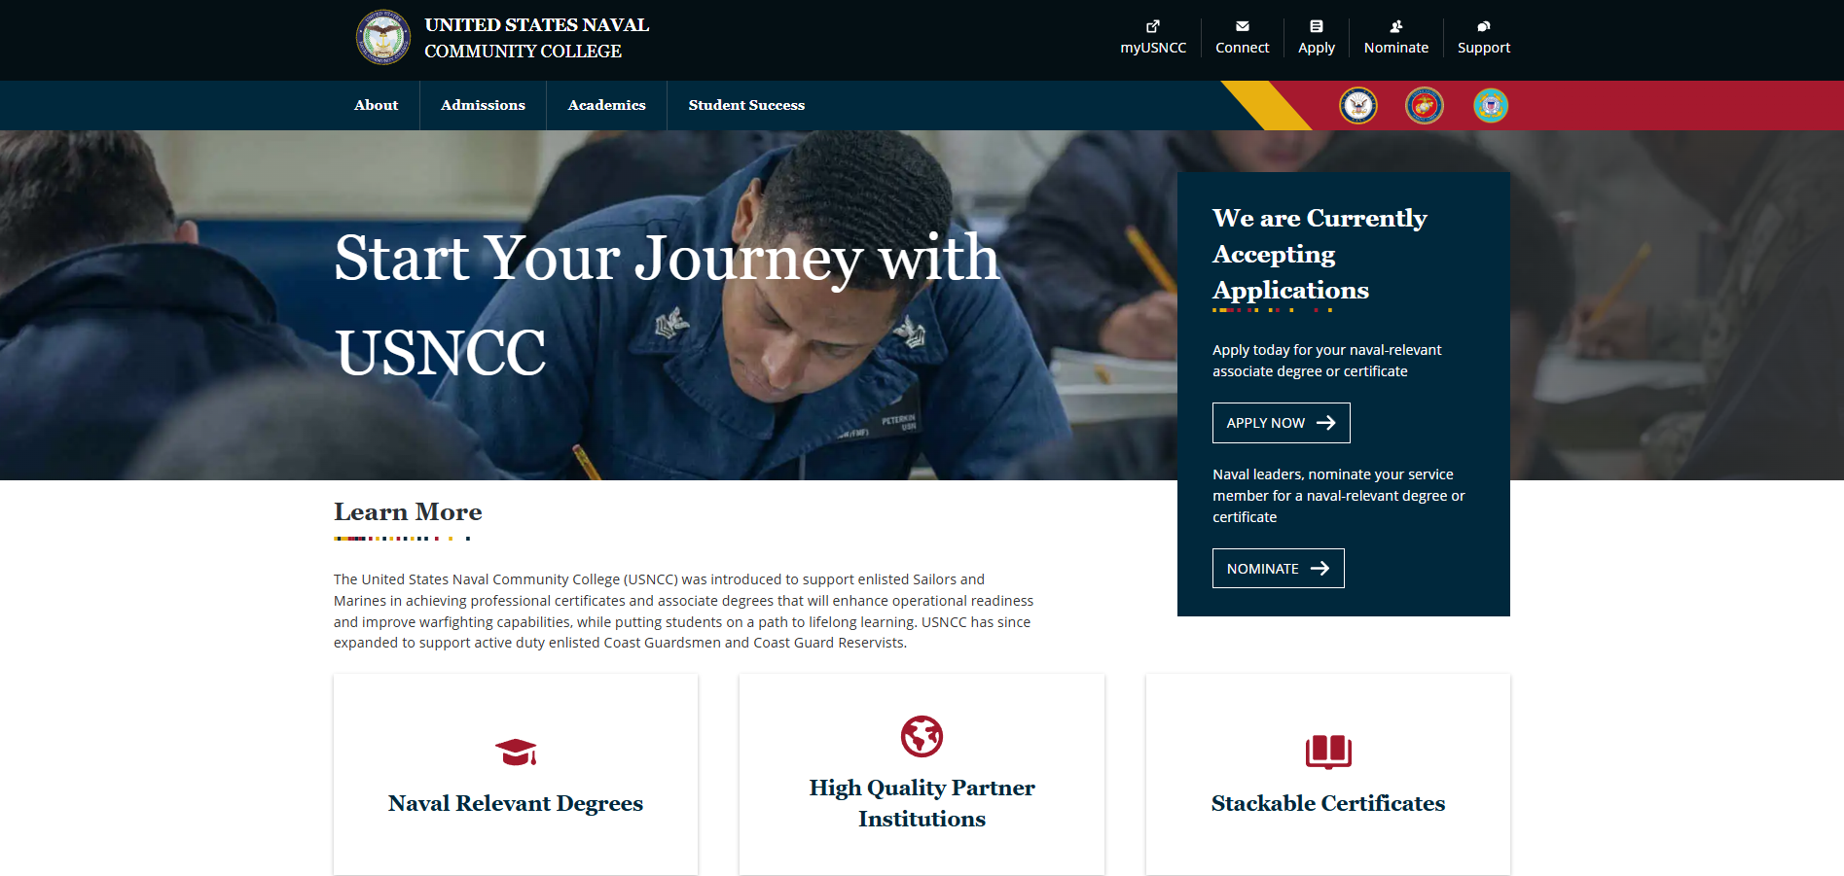
United States Navy Community College (USNCC)
Benefits to Sailors
Fully Funded certificates and associate degree programs
Pathways towards completing a Bachelors Degree
Credits EARNED DOES NOT deduct from TA benefits
Notes:
FACILITATOR GUIDE:
1. Provides naval-relevant associate degrees and certificates to enlisted service members in the U.S. Navy, Marine Corps, and Coast Guard.
Benefits to Service Member
Fully Funded certificates and associate degree programs
Pathways towards completing a Bachelors Degree
Naval-relevant education that matches up to private-sector
Credits EARNED DOES NOT deduct from TA benefits
2. All Sailors regardless of degree level can enroll in the Naval Studies certificate program.

Slide 11
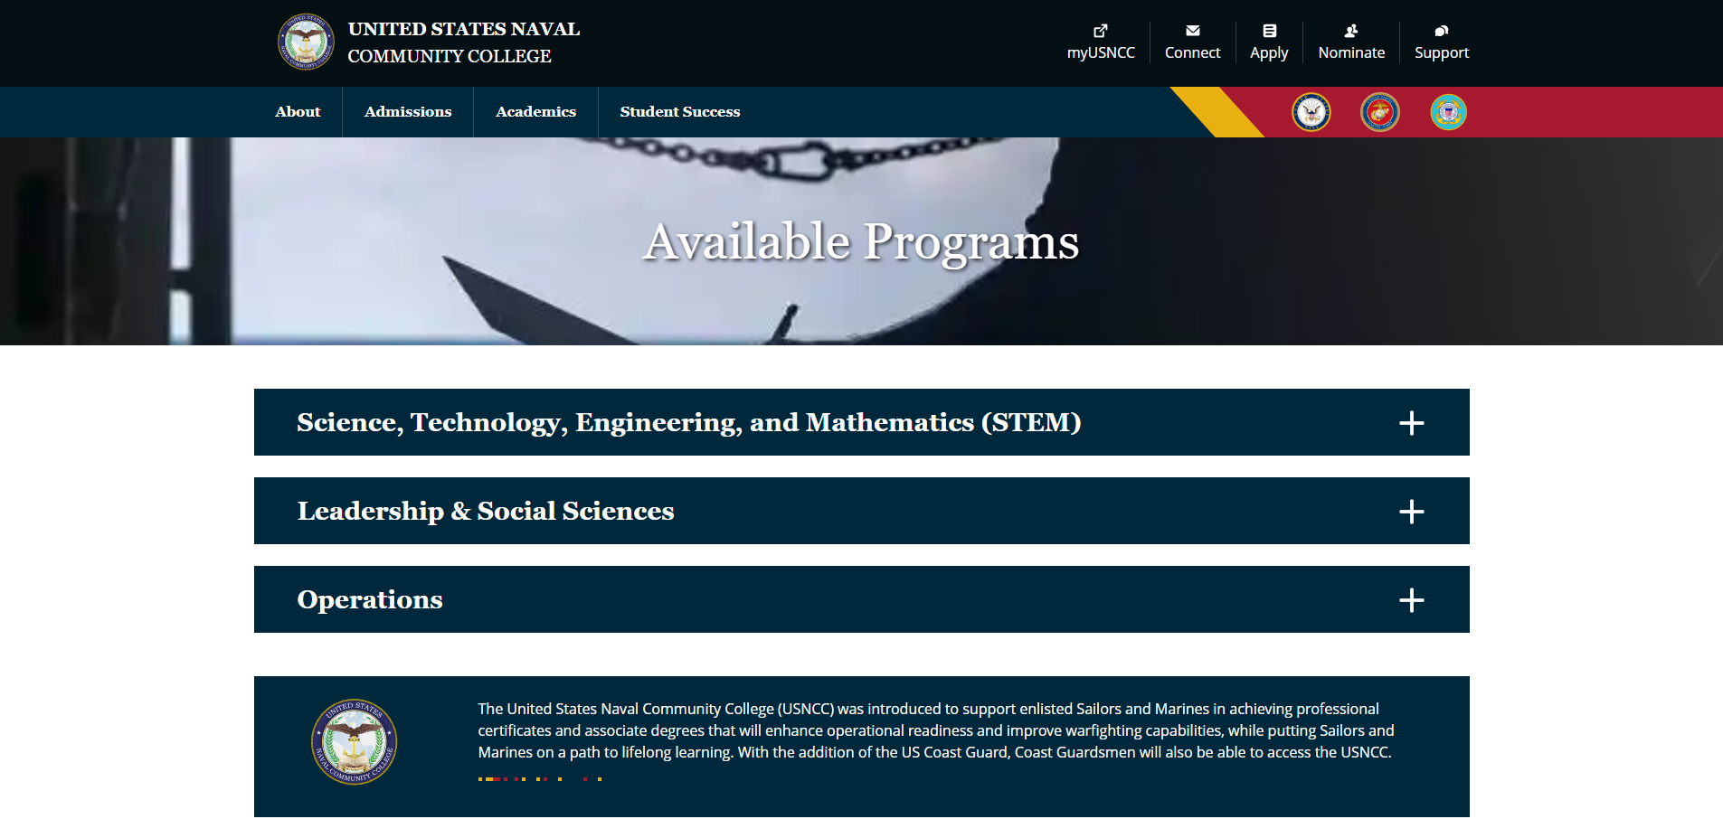
United States Navy Community College (USNCC)
United States Naval Community College (USNCC) offers a diverse range of associate degrees and certificate programs across three primary areas of study:
STEM
Leadership and Social Sciences
Operations.
Notes:
FACILITATOR GUIDE:
1. United States Naval Community College (USNCC) offers a diverse range of associate degrees and certificate programs across three primary areas of study: STEM, Leadership and Social Sciences, and Operations.
2. Science, Technology, Engineering, Mathematics (STEM): USNCC offers several Science, Technology, Engineering, and Mathematics (STEM) related programs designed to provide students with a solid foundation in their chosen field of academic study to include Cybersecurity, Computer Studies, and Nuclear Engineering. These programs incorporate naval-relevant education, cutting-edge curriculum, and subject matter expert faculty to equip students with the knowledge and skills necessary for success in the naval services and beyond. Colleges include Alexandria College (Technical and Community), Embry Riddle Aeronautical University (ERAU), Northern Virginia Community College (NOVA), UMGC, Western Governors University (WGU),
3. Leadership and Social Sciences: USNCC offers several academic programs specifically in leadership and social sciences, catering to students interested in furthering their knowledge and skills in a variety of areas to include military studies, organizational leadership, and naval studies. These programs provide students with a deep understanding of military principles, strategic decision-making, effective leadership techniques, and a comprehensive foundation and understanding of naval operations and history. Colleges include: Arizona State University (ASU)
4. Operations: USNCC offers diverse academic programs in operations, covering a wide range of fields such as aviation maintenance, uncrewed systems, and logistics. These programs provide students with the knowledge and skills necessary to excel in areas like aircraft maintenance and repair, the operation and management of uncrewed systems, and maritime logistics, preparing them for successful careers in the dynamic operational environment of the naval services. Colleges include: Arizona State University (ASU), Embry Riddle Aeronautical University (ERAU), and Tidewater Community College (TCC).
Review current programs, refer to the USNCC website for more information.

Slide 12

Joint Service Transcript (JST)
JST is an accepted document by the American Counsel of Education (ACE). Validates military experience/training with college credit recommendations
Allows Sailors to find different degrees By school, rating, and see what degrees and schools coincide with each rating
Is a recommendation to Schools for acceptance of military training as college credits. Not all schools will accept all recommended credits.
Notes:
FACILITATOR GUIDE:
1. JST is an academically accepted document approved by the American Council of Education (ACE) to validate service members military experience/training along with the corresponding ACE college credit recommendations.
2. Saves time and money by awarding academic credits, possible less tuition to pay, and less time spent in the classroom.
3. Provides a description of military schooling and work history in civilian language. Serves as a counseling tool for academic/career counselors in advising service members and veterans.
4. Recommend members regularly verify schools, NEC, and training reflected on their JST.

Slide 13

Navy Credentialing Opportunities On-Line (Navy COOL)
Benefits:
Every Navy rating and designator has at least one professional credential associated
Certifications and licensing enhance your military career while creating future opportunities in the civilian employment sector
Navy COOL covers expenses for certificates and examinations
Credentialing translates to greater rating knowledge, skills, competency, and personal fulfillment
Notes:
FACILITATOR GUIDE:
Provides Navy personnel to earn civilian certifications and licenses that correspond to their Service occupations, academic degree, off duty training, reserve occupation, and prior-service credentialing.
ADDITIONAL NOTES:
Benefits:
Every Navy rating and designator has at least one professional credential associated.
Certifications and licensing enhance your military career while creating future opportunities in the civilian employment sector.
Navy COOL covers expenses for certificates and examinations
Credentialing translates to greater rating knowledge, skills, competency, and personal fulfillment.

Slide 14
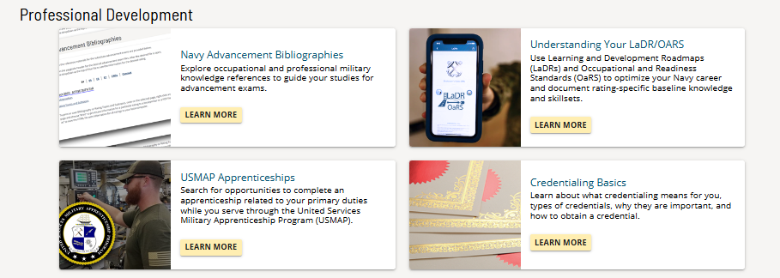
Navy Credentialing Opportunities On-Line (Navy COOL)
Navy COOL also contains the following:
Advancement Bibs
Occupational/Readiness Standards, and LaDR
Link to USMAP
Credentialing Information
Downloadable to mobile device either iOS or Android from the Navy App Locker
Notes:
FACILITATOR GUIDE:
Recommend reviewing the Navy Cool website if you are unfamiliar with the program.
ADDITIONAL NOTES:
1. Navy Credentialing Opportunities On-Line (COOL) website that provides information on how Navy personnel can fulfill requirements for civilian credentials related to their ratings, designators, and jobs.
2. The Navy’s Credentialing Program Office funds exam vouchers for active and reserve Navy workforce.
3. MILGEARS powered by COOL helps Sailors through all phases of the career lifecycle to plan and achieve professional and personal goals by highlighting career possibilities and helping you visualize how to reach those goals.
Refer to website for more information: https://milgears.osd.mil/
Question to ask the class: Does Navy Cool use TA funds?

Slide 15

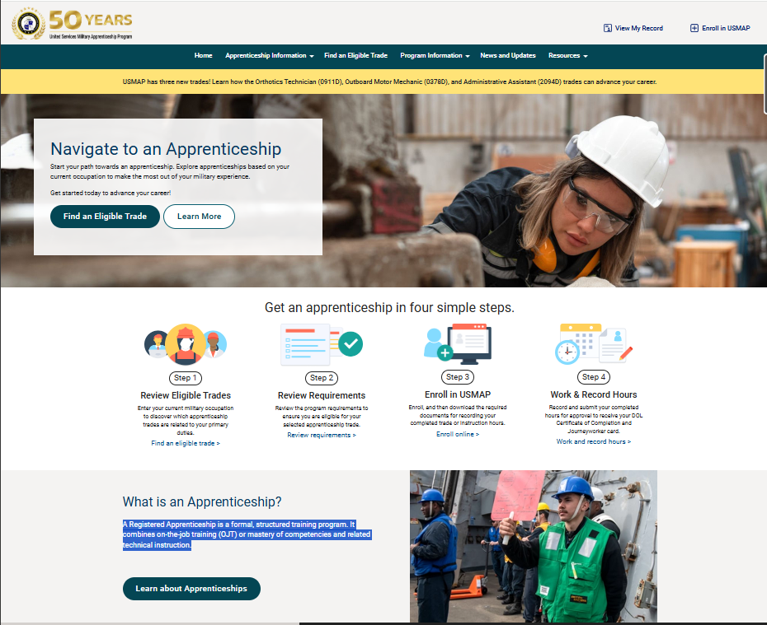
United Services Military Apprenticeship Program (USMAP)
Formal Military training program that provides opportunity to improve job skills and complete civilian apprenticeship requirements
Benefits:
Certified by Department of Labor (DOL)
Enhances job skills
Motivation for challenging assignments
Time (hours) or competency completions
Notes:
Facilitator Guide
1. USMAP is a formal military training program that provides enlisted Active Duty and Reserve Army, Marine Corps, Coast Guard, and Navy Service members the opportunity to improve their job skills and to complete their civilian apprenticeship requirements while serving their country. It is the largest registered apprenticeship program in the DoL. Service members can earn their civilian apprenticeship requirements through formal education, on the job training (OJT), or via a registered Apprenticeship which combines OJT and related technical instruction while on active duty.
Benefits:
Sponsored by the U.S. Department of Labor
Participants receive a nationally recognized “Certificate of Completion” from the U.S. Department of the Labor (DOL).
Enhances your military job skills.
Demonstrates your motivation for more challenging military assignments.
Time or Competency Based
Time: The Time-Based Apprenticeship is the traditional model. It requires you to log 2,000 to 6,200 hours to complete the trade by capturing your day to day work for those of any enlisted paygrade.
Competency Based: E-5 and above. These apprentices are expected to be able to demonstrate mastery of the competencies of their trade. Instead of Skill Areas and hours (Time Based method), the apprentice has Trade-specific Job Functions that contain Competencies.
A Registered Apprenticeship is a formal, structured training program. It combines on-the-job training (OJT) or mastery of competencies and related technical instruction.
Hands-on Career Training
Earn while you learn - you receive credit for workplace learning while you get paid to do your job.
Education
Gain workplace-relevant skills through on-the-job training, and you could earn academic credit toward a degree.
Increased Employability
According to the Department of Labor, 91% of people who complete an apprenticeship are still employed nine months later.
Industry Recognition
An apprenticeship is an industry-recognized and nationally-portable credential that can ease your transition to the civilian workforce after your military service.
Documented Work Experience
Detailed documentation of military experience can be shared with civilian employers and others to show equivalency to civilian jobs and credentials.
FACILITATOR GUIDE:
1. Identify the command USMAP Coordinator.
2. If time allows you can show the class the USMAP website
Additional talking points to add to the discussion:
Apprenticeships build self-esteem and make you more marketable for future employment.
Civilian employers recognize the value of apprenticeships and on-the-job experience which often translates into increased pay.
Also, you log the hours while doing the job at your command.

Slide 16
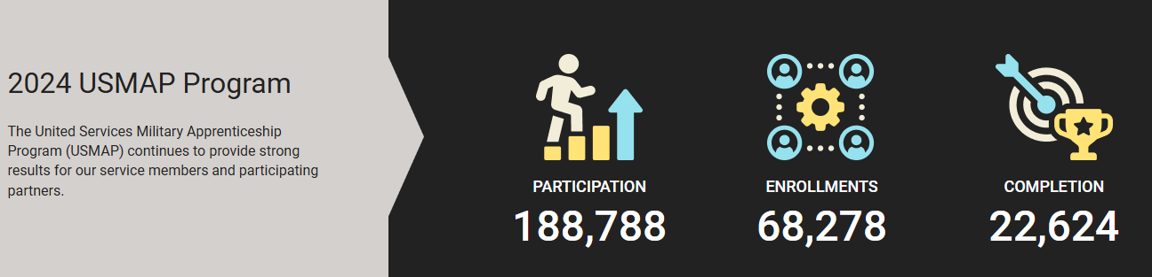
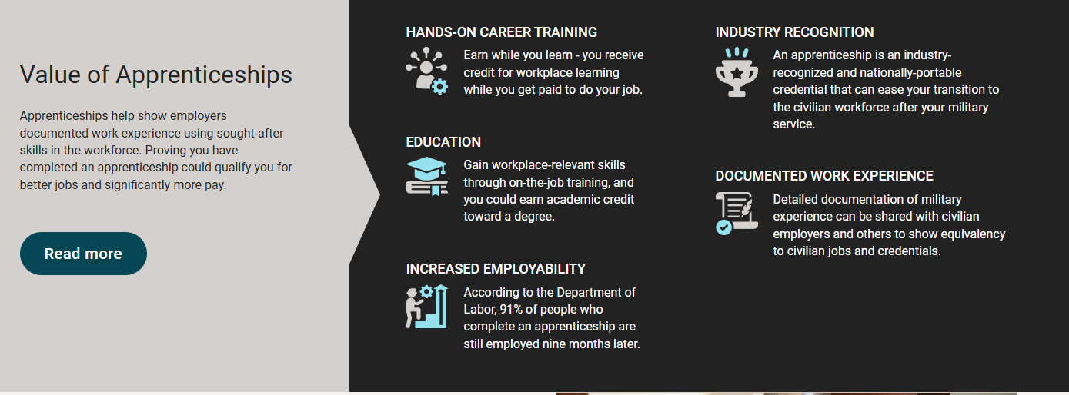
United Services Military Apprenticeship Program (USMAP)
Value From USMAP:
Completing apprenticeships leads to a 49% increase in earnings for service members, offering both immediate financial gains and higher lifetime income through new skills.
Employers benefit significantly, gaining $25,000 to $30,000 per apprentice, while apprentices contribute to company growth and increased earnings across industries
Notes:
Facilitators Guide
1. In 2024, over 188K Sailors are currently ACTIVE in the USMAP program and 22.6K have completed their apprenticeships. Meaning that those that completed these have higher chances for additional employment opportunities post Navy service and increases chances for advancement.
2. Enhanced Wage Growth and Lifetime Earning
Service members in apprenticeships experience a 49% earnings increase after completing the apprenticeship, highlighting immediate financial benefits and a path to higher lifetime earnings due to their new skills and certifications. According to the Department of Labor, 91% of people who complete an apprenticeship are still employed nine months later.
3. Employers see substantial returns, with direct and indirect benefits ranging between $25,000 and $30,000 per registered apprentice, while apprentices also boost company growth post-training, driving increased earnings across sectors
4. The value for apprenticeships allows Sailors to achieve the following
Hands on Career Training:
Education:
Industry Recognition:
Documented Workplace Experience:
Increased Employability:

Slide 17

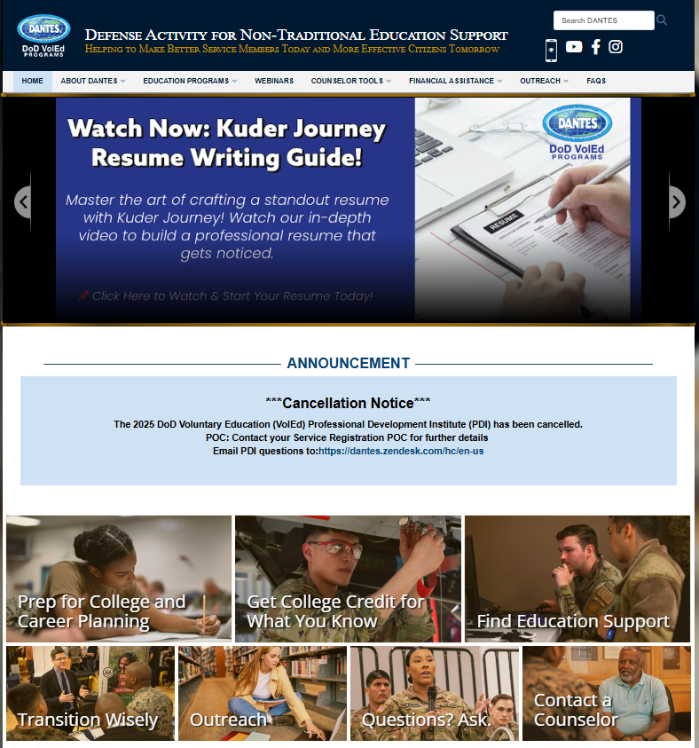
DEFENSE ACTIVITY FOR NON-TRADIONAL EDUCATION SUPPORT (DANTES)
DANTES manages a portfolio of education programs that help service members achieve their education and career goals.
Benefits:
College Prep
Education Support
Outreach programs
Notes:
FACILITATOR GUIDE:
What is Defense Activity for Non-Traditional Education Support (DANTES): DANTES manages a portfolio of education programs that help service members achieve their education and career goals. This includes Various programs include College and Career Counseling Program, DoD MOU College Comparison Tool (TADECIDE), Tuition Assistance (TA) for Postsecondary Degree Certificates/Programs, College Credit by Examination Program, Military Training Evaluation Program, and Overseas Education Support.
MISSION: DANTES manages a portfolio of education programs that help service members achieve their education and career goals. VISION: To lead in the delivery of quality education programs that make better service members today and more effective citizens tomorrow

Slide 18
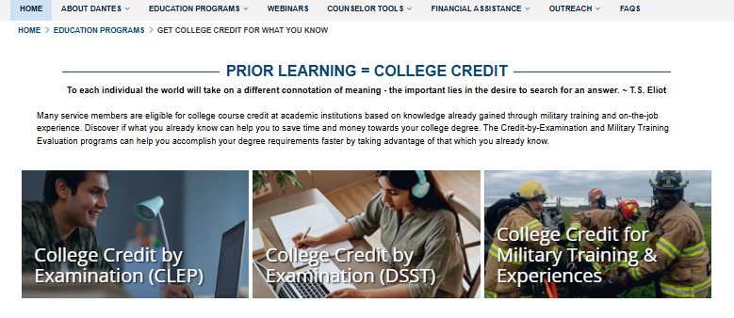
DEFENSE ACTIVITY FOR NON-TRADIONAL EDUCATION SUPPORT (DANTES)
Testing out of college courses, is simple via DANTES
CLEP Testing vs. DSST Testing
CLEP contains 30+ tests in 5 subject areas
DSST contains 30+ tests in 6 subject areas
Notes:
FACILITATOR GUIDE:
College credit recommendations for these exams are made through the American Council on Education (ACE) and are subject to the acceptance of individual academic institutions.
College-Level Examination Program (CLEP) and College Credit by Examination (DSST) Administered by The College Board. Allows Sailors to test out of subjects . CLEP covers 30+ tests that cover 5 subject areas and DSST covers 30+ tests that cover 6 subject areas
Fully-Funded: Test centers may be located on or off base. DANTES funds the administration and test fees for service members. Test Fee Only: Test centers are off-base colleges and universities that provide testing. DANTES funds the test fee. Service members are responsible for paying the administration fee. Fees vary by institution.
Remote testing requires a computer (no tablets or Apple computers, please), an approved testing environment, and a reliable internet connection.
For more information visit: https://www.dantes.mil/
Exams can enable college credit* that can be applied to meet degree requirements (*Subject to individual academic institutions)
Free test prep and study materials provided online, via mobile apps, and at installation libraries and education centers
Two types of test centers: Fully-Funded and Test Fee Only
Options for remote testing
Retests are not funded by DANTES-one attempt per exam title

Slide 19
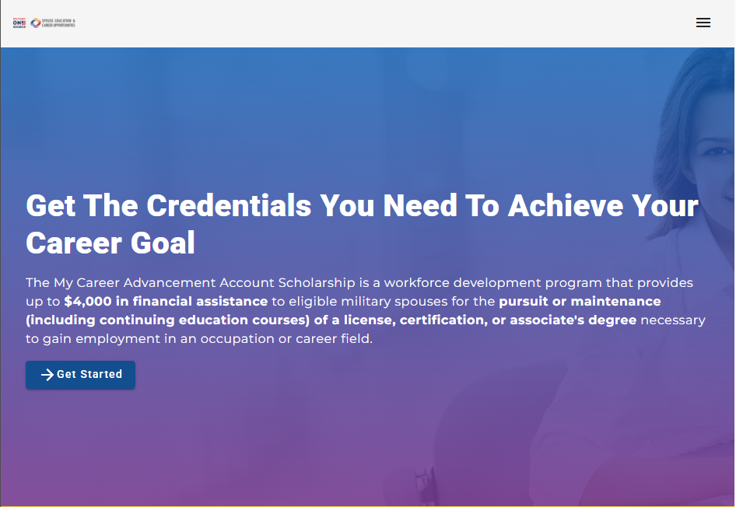
My Career Advancement Account Scholarship (MyCAA)
AA is a workforce development program that provides up to $4,000 in financial assistance to eligible military spouses
Provides up to $4,000 for college certificates, certifications and credit by-examinations to eligible military spouses
Notes:
FACILITATOR GUIDE:
1. MyCAA is a workforce development program that provides up to $4,000 in financial assistance to eligible military spouses for the pursuit or maintenance of a license, certification or associate degree necessary to gain employment in an occupation or career field.
2. Eligible spouses include: Active-duty and reserve members under Title 10 orders in pay grades E-1 to E-9, W-1 to W-3, and O-1 to O-3 who completed high school or obtained a GED
3. Provides free educational coaching and career guidance from a Spouse Education and Career Opportunities career coach. Coaches can provide education and training, career exploration, assessments and skills inventories, employment readiness and career search assistance.
4. Visit https://mycaa.militaryonesource.mil/mycaa/ for more information

Slide 20
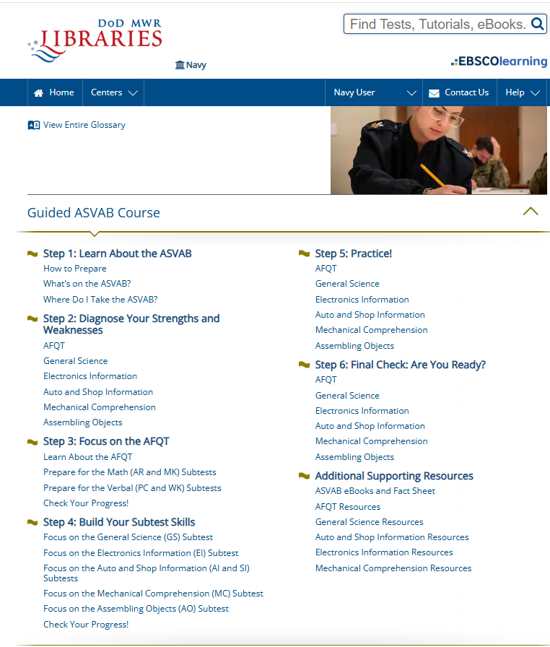
DoD MWR Library
Armed Forces Qualification Test (AFQT) (ASVAB Retake)
Additionally, DoD MWR Library now offers Sailors study prep for AFCT, career certification study guides, and job-related skills training
Notes:
FACILITATOR GUIDE:
1. DoDMWR Library offers a variety of different choices for study preparations. Since the sundown of the Online Academic Skills Course (OASC), this is now the latest and greatest for those interested in retaking their ASVAB test. The OASC was built specifically for military personnel, veterans, and their families, with a focus on core academic skills like reading, writing, and math. It seems to be primarily used to help with military advancement exams, entrance tests, or general academic improvement. Learning Express, on the other hand, is much broader. It was primarily designed for students, job seekers, and adult learners, offering test prep, career certification study guides, and job-related skills training. That said, it has quite a few military related options as well (at least via our DoD MWR Libraries account).

Slide 21

DoD MWR Library
DoD joint service initiative streamlining how MWR provides online access to library services and eResources.
Contains new library materials and upcoming programs at their local installation library; learn a new language; find a tutor; check out digital and audio books.
Notes:
FACILITATOR GUIDE:
DoD MWR Library
1. Because the internet is a popular and powerful tool for information access, education, and entertainment, the DoD joint service initiative is streamlining how MWR provides online access to library services and eResources - members can search for new library materials and upcoming programs at their local installation library; learn a new language; find a tutor; check out digital and audio books; these are just a few of the services to be offered in the new one-stop library shop. DoD MWR Libraries, encouraging and empowering Service members and families to embrace life-long learning.
2. DoDMWR Library offers a variety of different choices for study preparations. Since the sundown of the Online Academic Skills Course (OASC), this is now the latest and greatest for those interested in retaking their ASVAB test. The OASC was built specifically for military personnel, veterans, and their families, with a focus on core academic skills like reading, writing, and math. It seems to be primarily used to help with military advancement exams, entrance tests, or general academic improvement. LearningExpress, on the other hand, is much broader. It was primarily designed for students, job seekers, and adult learners, offering test prep, career certification study guides, and job-related skills training. That said, it has quite a few military related options as well (at least via our DoD MWR Libraries account).
3. Authorized Patrons
- Active duty military (Army, Marine Corps, Navy, Air Force, and Coast Guard).
- Members of the Reserve components and National Guard.
- Retired military, including retired from the Reserves and National Guard.
- Medal of Honor recipients and veterans with 100% service-connected disabilities.
- Eligible family members who are officially sponsored (ID card holder) by authorized patrons in the above categories.
- DOD and Coast Guard civilians, including appropriated and non-appropriated fund employees, when stationed outside the United States; stateside eligibility contingent upon resource availability.
- These are generalized categories; eligibility per DoDI 1015.10.
4. Visit https://www.dodmwrlibraries.org/ and https://www.dodmwrlibraries.org/continuing-education for more information

Slide 22
Montgomery G.I. Bill (MGIB)
The MGIB is a US Department of Veterans Affairs (VA) education benefit program for eligible service members and veterans.
It offers up to 36 months of education benefits for a variety of programs, including college, vocational training, and apprenticeship programs
Notes:
FACILITATOR GUIDE:
1. The Montgomery GI Bill (MGIB) is a US Department of Veterans Affairs (VA) education benefit program for eligible service members and veterans. It offers up to 36 months of
education benefits for a variety of programs, including college, vocational training, and apprenticeship programs.
2. Benefits:
Provides 36 months of educational benefits
Expires 10 years after separation from service
Payments are made directly to member monthly
Payment rates are available on the VA’s website https://www.benefits.va.gov/gibill
Can convert to Post 9/11 G.I. Bill

Slide 23
Montgomery G.I. Bill (MGIB)
Enrollment Process:
Eligible active-duty members will be counseled at least once within 270 days of entry on active duty
Members must be given a 90-day period in which to disenroll from the MGIB Program, if they wish. The 90-day period will begin the 180th day after entering initial training
Members who do not disenroll in writing before day 270 after entering initial active duty will be automatically enrolled in MGIB and have $100 per month reduced from their pay for the first 12 months
Notes:
FACILITATOR GUIDE:
Your ESO or CCC needs to counsel you within 270 days of entry on Active Duty for MGIB-SR election.
Sailor WILL have 90 days to disenroll from the MGIB program
90 days will begin after 180 days of entering boot camp. If members that DO NOT disenroll PRIOR to their 270th day, they’re enrolled in the MGIB and will have $100 per month
deducted from their pay for 12 months.

Slide 24
Montgomery G.I. Bill (MGIB)
Sailors interested in electing in the MGIB MUST complete the DD-2366 via NSIPS, member self-service. (Doesn’t apply to those that already elected to apply for the benefit)
Certified by a certifying official in NSIPS
Once certified, this will automatically upload to Sailors OMPF
After 270 days, the self-service function will NOT be available for use. Sailors would need to contact their Command Pay and Personnel Administrator (CPPA)
Notes:
FACILITATOR GUIDE:
1. Sailors interested in electing in the MGIB MUST complete the DD-2366 via NSIPS, member self-service. (Doesn’t apply to those that already elected to apply for the benefit).
2. Certified by a certifying official in NSIPS.
3. Once certified, this will automatically upload to Sailors OMPF.
4. After 270 days, the self-service function will NOT be available for use. Sailors would need to contact their Command Pay and Personnel Administrator (CPPA).
Further information is annotated in NAVADMIN 054/25

Slide 25
Post-9/11 GI Bill
US Department of Veterans Affairs (VA) benefit that helps eligible veterans and
service members pay for educational expenses like tuition, fees, housing, and books.
It’s available to those who served on active duty after September 10, 2001, and covers a variety of educational pursuits, including college degrees, vocational training, and on-the-job training
Notes:
FACILITATOR GUIDE:
Served at least 90 days on active duty (either all at once or with breaks in service) on or after September 11, 2001.
Served for at least 30 continuous days (all at once, without a break in service) on or after September 11, 2001, and were honorably discharged with a service-connected disability.
If you qualify tuition/fees are paid directly to school, monthly housing allowance, annual books and supplies stipend, and a one-time rural benefit payment of $500 to individuals who reside in a county with six people or fewer per square mile.
Review VA website for current details on Post 9/11.
https://www.benefits.va.gov/gibill

Slide 26
Post-9/11 GI Bill
To qualify for the Post-9/11 GI Bill (Chapter 33) you must meet at least one of below requirements:
Served at least 90 days on active duty (either all at once or with breaks in service) on or after September 11, 2001
Served for at least 30 continuous days (all at once, without a break in service) on or after September 11, 2001, and were honorably discharged with a service-connected disability
If you qualify tuition/fees are paid directly to school, monthly housing allowance, annual books and supplies stipend, and a one-time rural benefit payment of $500 to individuals who reside in a county with six people or fewer per square mile
Notes:
FACILITATOR GUIDE:
Served at least 90 days on active duty (either all at once or with breaks in service) on or after September 11, 2001.
Served for at least 30 continuous days (all at once, without a break in service) on or after September 11, 2001, and were honorably discharged with a service-connected disability.
If you qualify tuition/fees are paid directly to school, monthly housing allowance, annual books and supplies stipend, and a one-time rural benefit payment of $500 to individuals who reside in a county with six people or fewer per square mile.
Review VA website for current details on Post 9/11.
https://www.benefits.va.gov/gibill

Slide 27
Post-9/11 GI Bill
Transfer of Education Benefits (TEB):
Active duty, TAR or in the Selected Reserve who meet the following requirements may be eligible to transfer benefits:
Completed at least 6 years of service on the date request is approved
Complete a Statement of Understand (SOU) via the MyEducation portal
Have 4 or more years on contact at time of request
The person receiving benefits is enrolled in the Defense Enrollment Eligibility Reporting System (DEERS)
While on active duty, requests to transfer, change, or revoke a Transfer of Entitlement (TOE) are processed through MilConnect.
Notes:
FACILITATOR GUIDE:
1. Visit the link below for the most up-to-date information regarding transferability prior to briefing the slide.
https://www.va.gov/education/transfer-post-9-11-gi-bill-benefits/
2. Dependents may be able to get money to pay for these expenses:
Tuition
Housing
Books and supplies
Fees for national standardized tests
Fees for licensing and certifications

Slide 28
Post-9/11 GI Bill
Transfer of Education Benefits (TEB) Continued:
Spouses
Your spouse can use these benefits at any time. There’s no time limit on the benefits
Note: Your spouse doesn’t qualify for monthly housing allowance while you’re on active duty
Children
Your child can start to use these benefits only after you’ve finished at least 10 years of service. They can use these benefits while you’re on active duty or after you’ve separated from service
Your child must meet these requirements:
They can’t use the benefit until they’ve gotten a high school diploma (or a certificate that’s equivalent) or turned 18 years old
They must use these benefits before they turn 26 years old
Note: Your child may qualify for the monthly housing allowance even when you’re on active duty
Notes:
FACILITATOR GUIDE:
Ensure you make Sailors aware that only dependents on their DEERS are eligible, and the benefits do expire.

Slide 29
Post-9/11 GI Bill
Transfer of Education Benefits (TEB) Continued:
If transfer is successful and member is still in uniformed services member can:
Modify (add new dependents, change entitlement amount, or revoke) without incurring any additional obligated service
After separating from uniformed services:
Transferor may only modify entitlement for existing dependents who received at least “one” month of benefit
Note: Member has 30 days to complete transfer after their reenlistment date if reenlistment is 4 years.
Notes:
FACILITATOR GUIDE:
Once the TEB request has been approved, transferor may modify (add new dependents, change entitlement for existing dependents, or revoke entitlement) while serving in the uniformed services (active duty or SELRES) without incurring an additional obligation.
After separating from the uniformed services (active duty or SELRES), the transferor may only modify entitlement for existing dependents who received at least “one” month of transferred entitlement or revoke entitlement from any or all dependents. Entitlement may not be transferred to a new dependent, or an existing dependent with "0" months of transferred entitlement, once the transferor is no longer a member of the uniformed services.
Refer to MILPERSMAN 1780-011 for more information.

Slide 30
Montgomery G.I. Bill vs Post-9/11 G.I. Bill (Recap)
Montgomery G. I. Bill
Post 9/11 G. I. Bill
Benefits:
Provides 36 months of educational benefits
Expires 10 years after separation from service
Payments are made directly to Member monthly.
Cannot transfer to family/dependents
Can convert to Post 9/11 G.I. Bill
Benefits:
Provides 36 and up to 48 months of benefit. (Dependent on eligibility)
No EXPIRATION following separation from service
Payments are made to school, BAH and book stipend goes to member.
Can transfer to family/dependents
Cannot convert back to MGIB
Notes:
FACILITATOR GUIDE:
There are differences between the Montgomery G. I. Bill and Post 9/11 G. I. Bill.
2. MGIB:
Benefits:
Provides 36 months of educational benefits
Expires 10 years after separation from service
Payments are made directly to Member monthly.
Cannot transfer to family/dependents
Can convert to Post 9/11 G.I. Bill
3. Post 9/11:
Benefits:
Provides 36 and up to 48 months of benefit. (Dependent on eligibility). If you have 2 or more qualifying periods of active duty, you may now qualify for up to 48 months of entitlement. You must be eligible for the Post-9/11 GI Bill and the Montgomery GI Bill Active Duty (MGIB-AD) (Rudisill decision).
No EXPIRATION following separation from service
Payments are made to school, BAH and book stipend goes to member.
Can transfer to family/dependents
Cannot convert back to MGIB
Full Benefit details are lised on the VA website for ALL VA related education programs.
https://www.benefits.va.gov/gibill
Note: Even if you gave up your right to use MGIB-AD benefits in the past (we call this “relinquishing” your benefits), you may now qualify to use some of that entitlement.

Slide 31
Knowledge Check
Does Navy COOL cover expenses for certifications/examinations?
Where do you find information to retake your AFQT?
Can you transfer your Montgomery G. I. Bill Benefits to your family/dependents?

Slide 32
Summary and Review
Navy's Voluntary Education Program
Tuition Assistance
Navy College Program
United States Navy Community College (USNCC)
Joint Service Transcript (JST)
Navy Credentialing Opportunities On-Line COOL (Navy COOL)
United Services Military Apprenticeship Program (USMAP)
DANTES
MyCAA
DoD MWR Library Resources
Montgomery G. I. Bill and Post 9/11 GI Bill
Notes:
FACILITATOR GUIDE:
Below are knowledge check questions to ask the class:
What is the significance of VOLED?
What is the timeline for TA submission?
Who can apply for Navy Community College?
What additional programs fall under Navy College Program?
When are Sailors eligible to transfer Post 9/11 education benefits to their dependents?

Slide 33
Questions?
Notes:
FACILITATOR GUIDE:
Questions to ask the class:
What is the purpose of a CDB? What is the CDB Schedule? What is the PACT CDB Schedule? How many years is your MSO? Where to find LaDR? Timelines for TAPS?
Presenter can tailor review questions to the audience.

